Slide 1
Project 3 Confidence Intervals
CISC 820
Lu Dong Gina Girgis

Slide 2
Introduction
Objectives:
Generate synthetic datasets and input them to functions.
For each function, discuss three things of the CI
Valid or not ?
If so, at what level?
Is it valid only asymptotically, or for all dataset sizes?

Slide 3
Generate the data
Sample from three distribution:
Normal distribution(N):
X= sample_normal (N,1,0), mu=0
Bernoulli distribution(B):
X= sample_bernoulli(N,0.5), mu=0.5
Uniform distribution (U):
X= sample_uniform(N,0,1), mu=0.5

Slide 4
Design testing procedure
Send X to Ci function [a,b]=ci(X,f), it returns a pair of [a,b].
Compute ep by equation ep=1/2*(b-a).
Compute how sample mean captures the true mean.
if a<=mu && b>=mu
count=count+1;
Print the following results: (function_no, N, ep, frac missed),
where ep is the mean_ep, and frac missed computed by
1-count/10000.

Slide 5
The reasoning for valid
Based on definition:
Pr[An<=mu<=Bn]>=1-alpha
Set a false mu, to observe prac miss value .
if prac miss close to 0, that means they caputure a wrong mu.
Central Limit Theorem (CLT), the sample mean Xbar follows a normal distribution. As N increases, the ep value is supposed to decrease. (meaningful)
Function 4, 5, 6 are invalid.

Slide 6
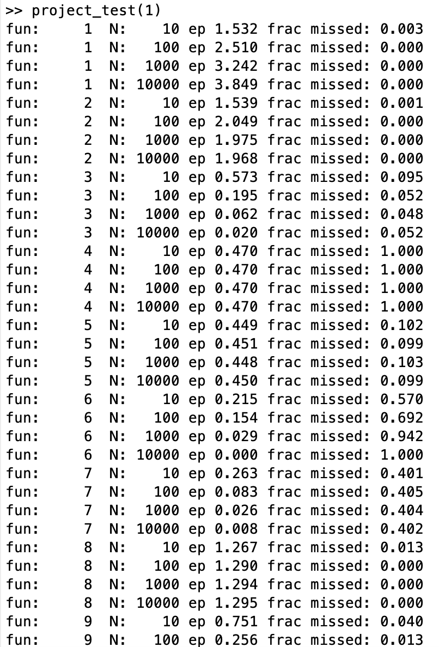
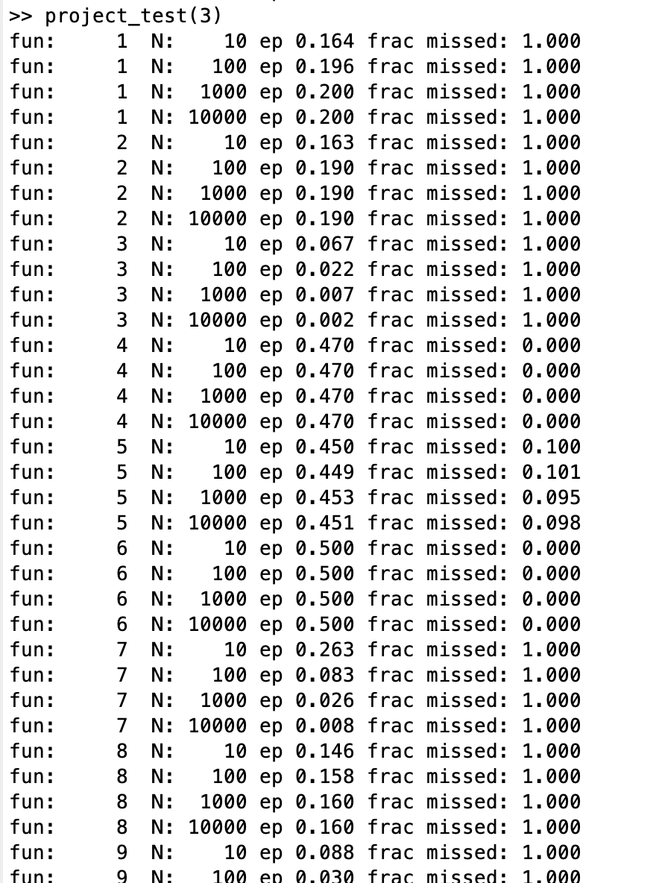
X = sample_normal(N,1,0);
mu= 0;
X= sample_uniform(N,0,0.4);
mu= 0.5;
Function 4, 5, 6
is invalid.

Slide 7
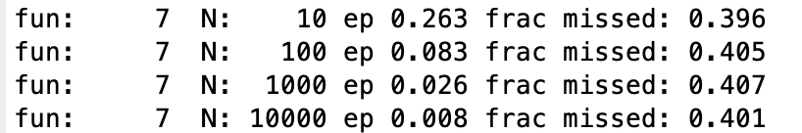
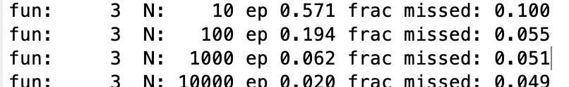
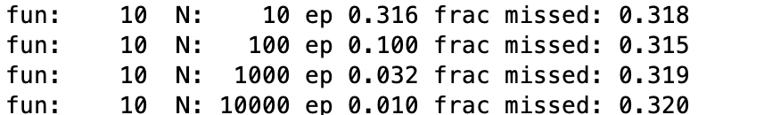
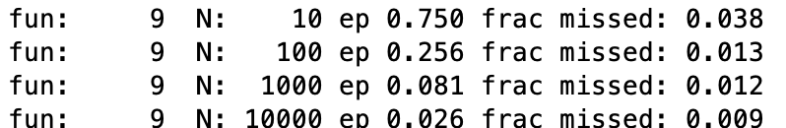
The reasoning for all dataset sizes or asymptotically
If it’s valid for all dataset sizes, the frac missed value will converge no matter how large the N value is.
However, if it’s valid asymptotically, the frac missed value will only converge when N is larger.
The CI Function 1,2,7 ,8 and 10 -- valid for all dataset sizes
The CI from function 3 and 9 -- valid only asymptotically.

Slide 8
The reasoning for CI level:
The converge value of frac missed will reflect the CI level.
alpha is supposed to be a bit higher than frac missed.
We test normal/bernoulli/uniform distribution,
For 1,2,8, their CI level is 0, always true. Not meaningful.
Fun 3 and 9, the CI level is respectively 0.05 and 0.01.
Fun 7 and 10, the CI level is affected by the sample distribution.
Fun 7 is 0.4/0.1/0.005.
Fun 10 is 0.3/0.05/0.001.

Slide 9
Conclusions:
Function_No. | Valid? | What Level? Distribution:N/B/U | For all datasizes or only asymptotically?
1 | Yes | 0/0/0 | all dataset sizes
2 | Yes | 0/0/0 | all dataset sizes
3 | Yes | 0.05/0.05/0.05 | Asymptotically
4 | No
5 | No
6 | No
7 | Yes | 0.4/0.1/0.005 | all dataset sizes
8 | Yes | 0/0/0 | all dataset sizes
9 | Yes | 0.01/0.01/0.01 | Asymptotically
10 | Yes | 0.3/0.05/0.001 | all dataset sizes

Slide 10
Thank You Q&A

